Slide 1
Soccer past and present
Interviewer: Are Barcelona as good as they were when they won the UEFA Champions league against Manchester United?

Slide 2

Yes, Barcelona have won the Champions League since winning against Manchester United.
Interviewer: Which do you think is the more important trophy, the Europa Cup or the UEFA Champions League?

Slide 3
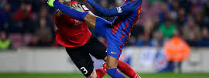
The Champions League is more important because it`s for champions.
Interviewer: How are Barcelona since they beat Manchester United in the Final of the Champions League?

Slide 4
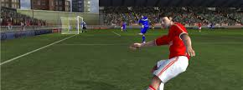
Barcelona are better than they were because they won the UEFA Champions League again.
Interviewer: How are Manchester United since their defeat to Barcelona?

Slide 5
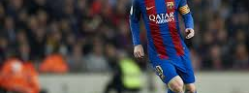
Manchester United won the Europa Cup but not the Champions League.
Interviewer: Which is more successful, Barcelona or Manchester United?

Slide 6

It`s difficult to know, because they play in different countries; England and Spain. I think Barcelona are more successful than Manchester United, because Barca win more European trophies.
Interviewer: On behalf of the audience, thank you for answering my questions.

